Slide 1
Ecosystem building
Speakers:
Angeles Tejado - Senior Marketing Manager - FIWARE Foundation
Nina Doklestic - Marketing Specialist - Fundingbox

Slide 2
Agenda
About:
This first part of the session will focus on i4Trust Ecosystem Building activities and the i4Trust Communication and Dissemination Strategy
This session will:
Introduce the i4Trust Ecosystem main actors / roles
Engagement objectives: liaisons and synergies with other projects
Messaging Framework and Benefits
i4Trust Milestones & Communication Plan: Channels & Target audiences
Customer Journey and Marcom Funnel
i4Trust Community platform and Q&A
Goals:
After this session you will understand i4Trust Dissemination and Communication Strategy, your role in the journey, how to engage/liaise with stakeholders and how the Community platform is connected to this journey
Target Audience:
SMEs, DIHs, Data Marketplace providers, Platform Providers (Software Platform Providers and Cloud Providers), Data Sharing Experts, Policy Makers.
Notes:
Going beyond the technology
i4Trust Community platform and Q&A
OnBoarding: the role of DIHs
Overview and Journey of DIHs
Role of DIHs
- i4Trust Ambassadors
- LEBDs and Engagement in Multi-tier support
- i4Trust community structure
How the open calls will work
- Overview of the Open Call process
- What constitutes a suitable i4Trust experiment
- Scouting process
Support to experiments
FAQ

Slide 3





i4Trust: beyond the technology
Training Technical Support
<
Ambassador DIH
32 BuE – 150+ SMEs
(Bottom-up Experiments)
Digital Innovation Hubs (DIHs)
Cluster Value Chains
Future experiments
Market solutions
SMEs
Experiments
Data Spaces PoC
Community
Community Platform Community Mgmt

Slide 4
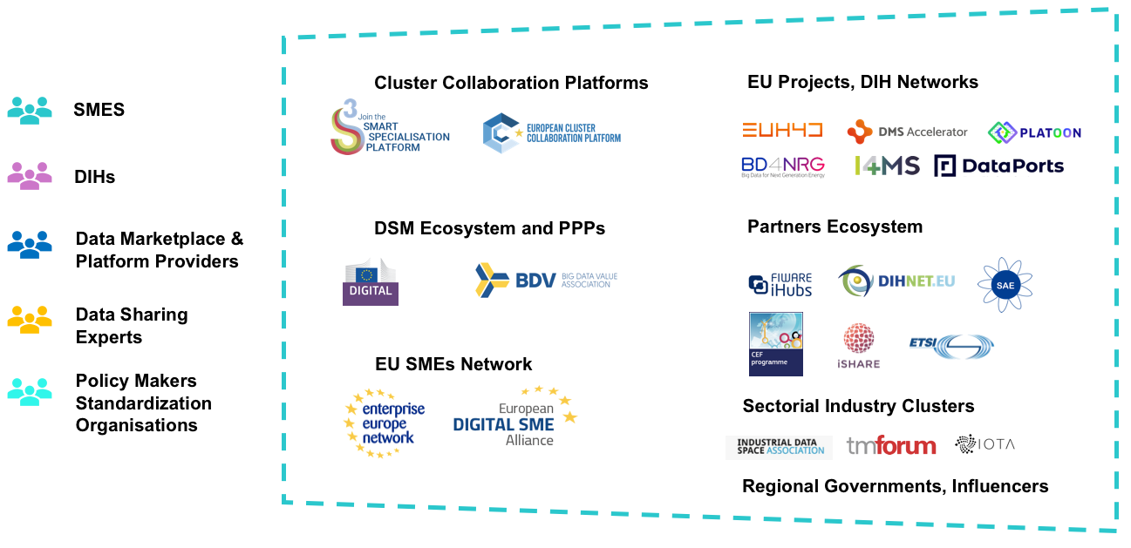
i4Trust main actors
Notes:
1.SMEs with not yet Data Driven Business: early adopters to news cross-domain experiments and data-driven business concepts.
2.SMEs with a position in using and re-suing of data: contributing and sharing data; strong competence in management of data.
3.SMEs with a strong ability to share any kind of data: contributing and sharing data from third parties; Data Marketplace & Publication Services (e.g. companies, organization, Cities).
i4Trust's main goal is to empower SMEs to develop innovative services in different sectors based on sharing of data across value chains, resulting in a significant increase in the amount of data shared, and breaking information silos. SMEs have been traditionally involved in supportive initiatives that provide access to data pools for the development of solutions, but there are still barriers for a real data-driven innovation where data is seamlessly extracted, managed and shared in a trusted environment by different players that collaborate to extract value out of it, enabling a variety of smart applications that improve everyday life.

Slide 5
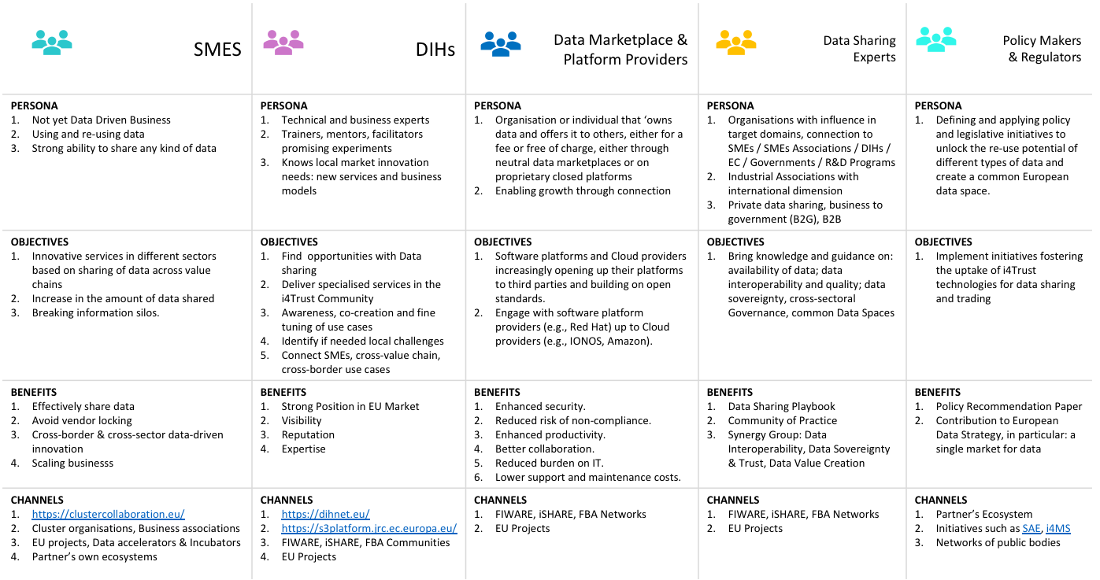

Slide 6






Engagement objectives, liaisons and synergies
Establish the i4Trust Community with a wide range of services, information and tools that will allow stakeholders to communicate, align, collaborate and share knowledge;
Define the ecosystem framework to attract and engage DIHs, establishing specific actions to activate them like the i4Trust Ambassador Programme;
Fostering a data driven approach into SMEs in sectors which are not yet data-driven within industrial value chains such as Smart Cities, Smart Mobility, Smart Manufacturing, Smart AgriFood, Smart Energy, Smart Water, Smart Health and Smart Logistics.
Collaboration with other EU initiatives and Clusters that want to contribute to the creation of European Data Spaces based on common principles.
Synergy Group
Task Force 1
Data Spaces Technology Building Blocks
Task Force 2
Business & Legal frameworks + Policy Recommendations
Task Force 0 Coordination
Task Force 3
Ecosystem building & Communication

Slide 7
i4Trust Messaging Framework
SMEs and DIHs
Data Marketplace providers
Data Sharing Experts
Policy Makers & Influencers
DSM Ecosystem and PPPs
Cluster Collaboration Platforms
Industry Clusters
Partners’ Ecosystems & Related EU Projects
Regional Governments
TARGET GROUPS
CORE MESSAGE
i4Trust - Data Spaces for effective and trusted data sharing
The i4Trust’s ecosystem will enable companies to share data in a trustworthy
and effective manner, breaking down ‘data silos’ through the sharing, re-use and trading of data assets, boosting collaboration with other parties for the creation of innovative services related to new data value chains in different sectors.
BRAND PROMISE
Open source standard-based technologies
Data Exchange APIs
Standard Data Models
Data Sovereignty and Trust: common mechanisms for IAA
Democratizing opportunities
Data Marketplace & Publication Services
CEF Compatible
Reuse, don’t reinvent
Deep Tech Ecosystems and Communities: experts, SMEs, DIHs
REASONS TO BELIEVE
TRUSTWORTHINESS
SOVEREIGNTY
EFFECTIVENESS
BRAND VALUES
OPENNESS
CROSS-DOMAIN
INNOVATION
GROWTH
Boost the development of innovative services related to new data value chains in multiple sectors
MISSION
A sustainable ecosystem and vibrant Community around Data Spaces for effective and trusted data sharing
VISION

Slide 8







i4Trust Values
TRUSTWORTHINESS
Thanks to the unified framework for identification and the robust legal frameworks that i4Trust brings, you can trust the participants you exchange data with.
SOVEREIGNTY
i4Trust brings the means for enforcing the data access and usage policies you want to define, bringing you the power to be the sovereign of your data.
EFFECTIVENESS
Designed for the exchange of data among Smart Solutions, i4Trust brings a standard data exchange API and data models guaranteeing you to effectively share data
OPENNESS
i4Trust is open, based on open-standard and implemented as Open Source, allowing you to avoid vendor lock-in, thus protecting your investment and reducing costs.
CROSS-DOMAIN
i4Trust unleashes the potential of data sharing among different participants in multiple domains, allowing you to define cross-domain data value chains.
INNOVATION
By combining tools enabling multi-side markets and the ability to monetize data, i4Trust will bring you the opportunity to create innovative business models.
GROWTH
i4trust Community is formed by experts engaged in a process of collective learning and human endeavor to scale your business and gain stronger position in the market.

Slide 9
i4Trust Milestones
Community of Practice
Data Sharing Enablers
Train of Trainers (T1 / T2 Experts)
Onboarding Help-Desk
Ambassador Programme Action Plan
Mapping & Welcome Pack
Liaison EU Projects
Win-Win Communication actions
Open Calls Launch
Challenges by DIHs Working Groups & Advisory Board
Open Call Package
Help Desk
1
2
32 DIH Ambassadors
100 Potential Applications
2
DIHs Activation
Testing DIHs WG
Comms Plan
i4Trust Community
Scouting of promising experiments
SMEs Awareness
Outreach Actions: Potential Use Cases
Open Call Promotion
International Info Days
National Info Days
Info-corners
Webinars
Data Sharing Mentoring Programme - Mentors
Mentoring Programme for BuEs
Train the Trainers for Mentors
Welcome Camp
Exploitation and Sustainability Plan
BuEs Portfolio
CoP New Members - Data Sharing Playbook
Whitepaper lessons learned
3
4
32 BuEs
Data Sharing Mentoring Programme - BuEs
Onboarding
Use Case Plan - Cross-Value Chain Bootcamp
Proof of Concept
Promotion
Best in Class Showcases
Fundraising Bootcamp
CoPs Promotion

Slide 10
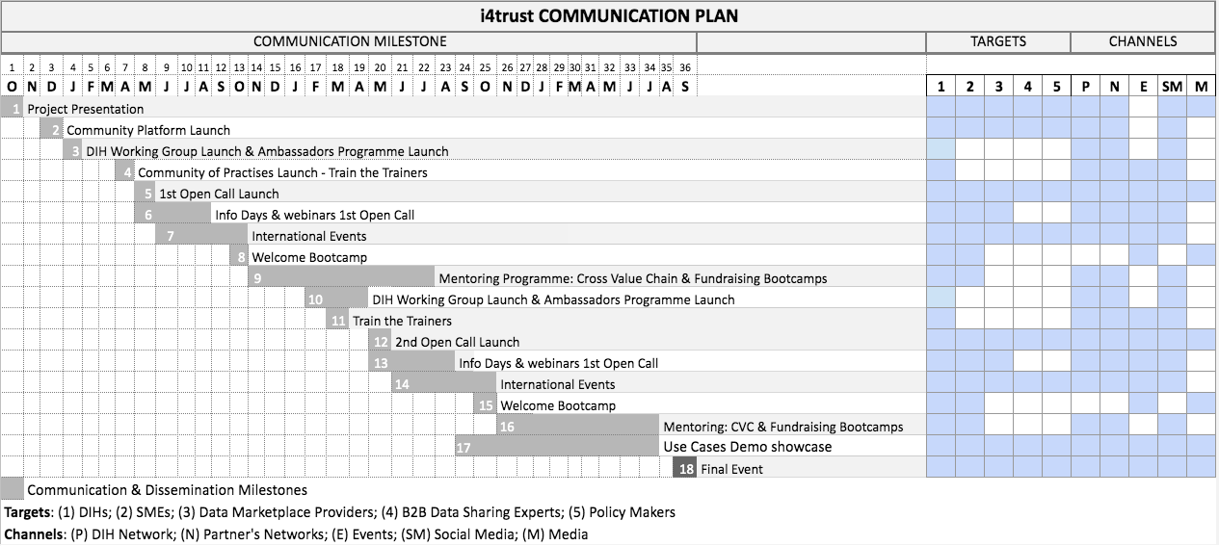
Communication Plan: channels and target audiences

Slide 11
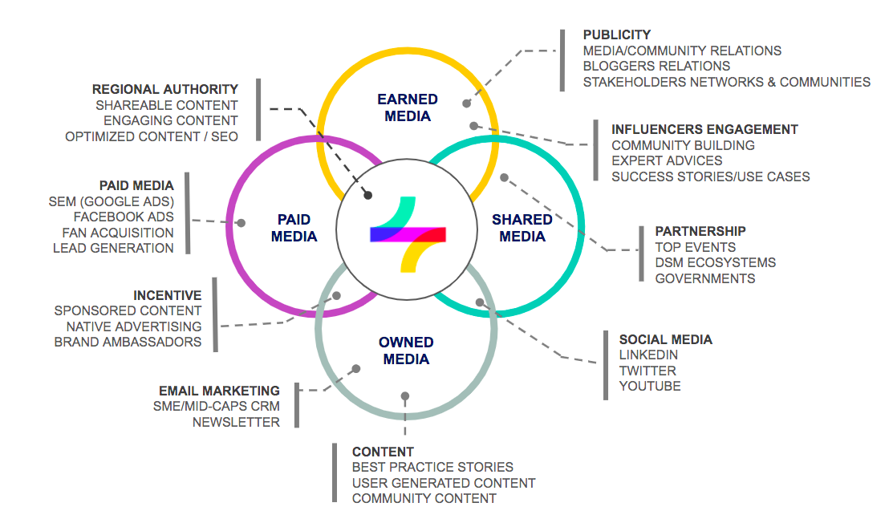
Communication Plan: PESO Model

Slide 12
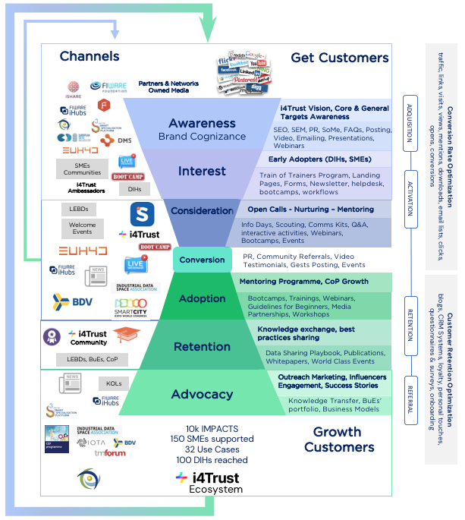
Customer Journey
Marcom Funnel

Slide 13
Phase I
Awareness, Engagement - Acquisition
Phase II
Inform / Interact
Activate Interest
Phase III
Promote Commercial Exploitation
Dissemination Activities
Webinars & Info Days
Project launch and Vision awareness
DIHs Activation
Open Call Promotion
Train the Trainers
Ambassador Programme
Scouting
Mentoring
Technology and Knowledge transfer
Standardization Activities
Objectives: 10 Info Days Open Call + 6 DIH Activation - 4 Train the Trainers - 2 web based Open Calls
Open Call Promotion - Info Corners
Speaker Presentations - Positioning
Vertical and local approach - Industrial focus
Synergy Group
Success Stories
BUEs Portfolio
Business & Market Outreach
Conferences & Workshops
https://drive.google.com/file/d/1SoXDPnC5eZLU0IYWoriXkTrqT5fl74mb/view?usp=sharing
Objectives: 6 EU Events + 4 World Class Events (info corners and promo of results)
Train the Trainers Bootcamps
Welcome Bootcamps (Open Calls)
Industrial focus and Investment - Demo exhibition - Fundraising Bootcamp
Cross-Value Chain Bootcamp - Community best practices
Demo & Showcase Bootcamps
Publications
Publications in relevant web portals related with European networks of DIH - Cluster organizations and Business Associations
Publications in relevant journals
Proof-of-Concept Portfolio / 1 Policy Paper / Data Sharing Playbook
Community Building
i4Trust Spaces - Community Entry Points and Social Media Channels
Content Curation – Webinars, Use Case Stories, SW Releases, Position Papers, Influencer outreach
Targets: SMEs, DIHs, Data Marketplace providers, Platform Providers (Software Platform Providers and Cloud Providers), Data Sharing Experts, Policy Makers.
Federate and connect the relevant projects, actions and initiatives, as well as Digital Innovation Hubs, that can contribute to the creation of European Data Spaces and collaborate in standardization activities.
Engage with End User target audiences
Engagement with Stakeholders

Slide 14
Phase I
Awareness, Engagement - Acquisition
Phase II
Interest, Consideration - Activation
Phase III
Conversion, Adoption – Retention
Communication Activities
Project Website
Design and develop and intuitive and responsive website. SEO Positioning and Keywords
Main entry point together with the Community. Positioning articles, update on events and news. Supportive promotion DIHs
Continuous update of the website content, clear visibility of results, training material available in an interactive way
Social Media
Positioning and updates, animated banners, social cards
Combination of organic and paid
Promote i4Trust Community activities & Open Calls, interact with followers, reproduce relevant content and monitor relevant keywords, upload public material – Training – Position papers – Use Cases – Toolkits - Webinars
Community Spaces
Meeting point for DIHs and SMEs, news & events, engagement, help desk, working groups
Project Positioning, Experts Posting, Updates on Trainings, Communications, Ambassador Programme
Experiment Promotion – Testimonials – Demos – Chat Interviews
Media
PR Project launch – Open Calls - Newsletters
Stakeholders Engagement - Media Partnerships campaigns - Newsletters
Outreach, Influencers Engagement, Use cases and business cases of project results - Targeted media - Newsletter
Communication Material
Visual identity, banners, newsletter, promo videos, Flyers, Comms Kits, Blog/News
Banners, Flyers, newsletters, blogs/news, Infographics, Value Prop Video
Position Papers, banner, newsletters, blogs/news, infographic, video, impact stories, onsite event promo
Partner’s Communities
Identify synergies and establish contact points, exchange of ideas and intentions
Periodic bilateral exchange of news and results, joint presence in international events
Joint engagement in events / demo sessions

Slide 15













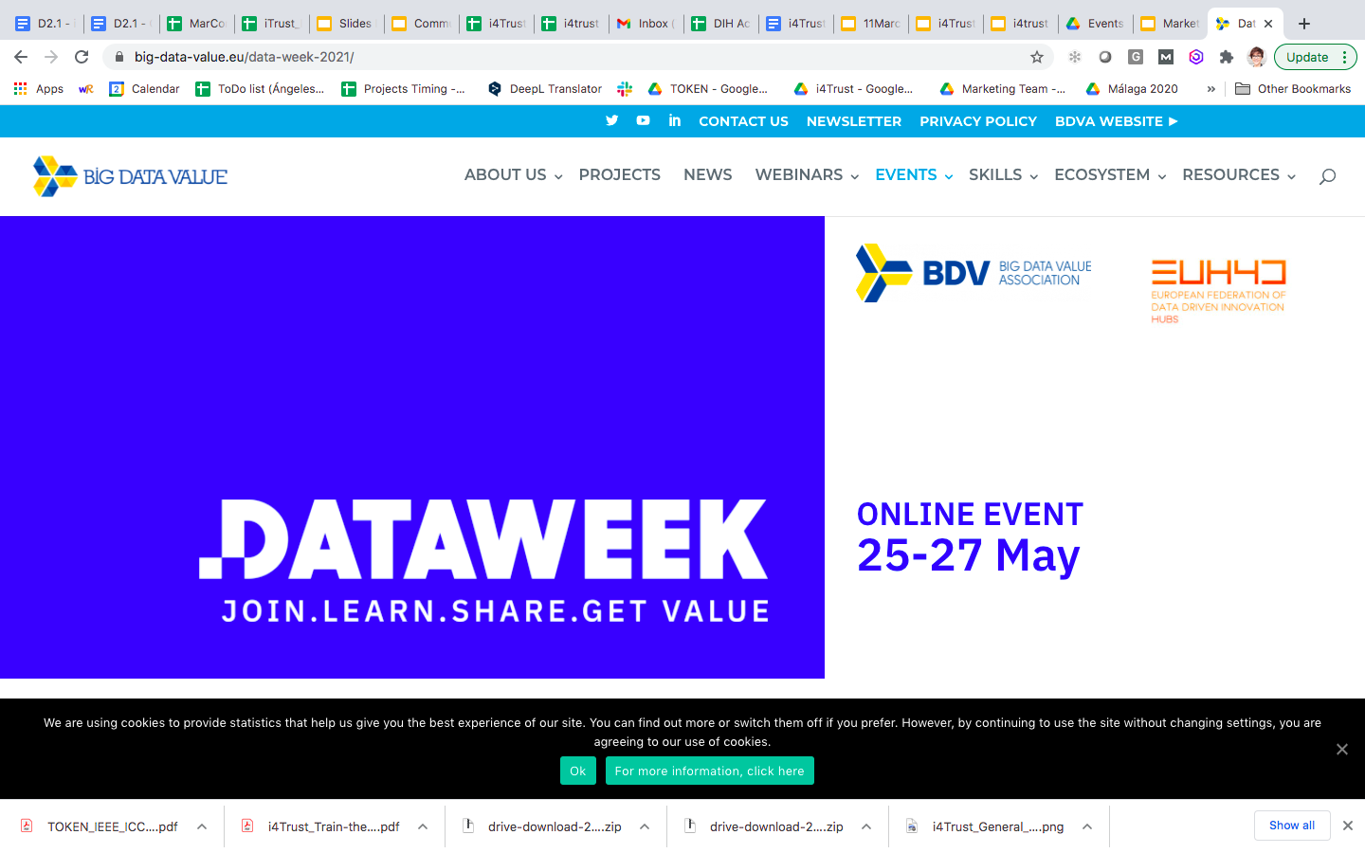
Planned Events
Hamburg GERMANY
April
Hannover
28/06– 01/07
Barcelona
22/06– 23/06
Virtual
Berlin GERMANY
Barcelona
SPAIN
Málaga
SPAIN
10 June
JAN
FEB
MAR
APR
MAY
JUN
JUL
AUG
SEP
OCT
NOV
DEC
08/06 - 10/06
FIWARE FEST
Barcelona
SPAIN
25/05– 27/05
Virtual
16, 17, 18 June
FIWARE
Camp

Slide 16
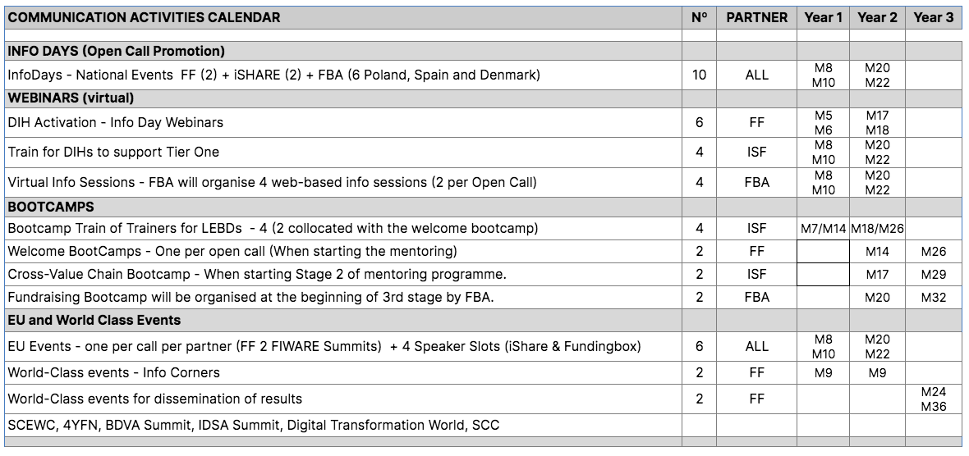
Planned Events

Slide 17
Why we do it?
i4Trust community is a hub, for peer-to-peer collaboration, a Space to connect and belong
It’s a place for knowledge exchange, interaction and contribution around project’s activities and outcomes
Our goal here is to create a ‘thriving and vibing’ community for all i4Trust stakeholders, by:
Keeping you updated on all the the project activities
Growing awareness about the benefits of i4Trust initiative for data sharing
Fostering the data driven approach into SMEs in sectors which are not yet data-driven
Boosting the uptake of data sharing and trading technologies promoted by the i4Trust
Supporting potential Open Call applicants
Sharing the i4Trust Best Practices

Slide 18

About The platform
Fundingbox Spaces platform: https://spaces.fundingbox.com/
What FundingBox communities have to offer?
Information
Inspiration
Support
Connections
Companionship
30K
20
250
30k registered Innovators
20 active
communities
250 Digital Innovation Hubs

Slide 19


Now...meet the i4Trust Community
https://spaces.fundingbox.com/c/i4trust

Slide 20


Slide 21
Follow @i4Trust on Twitter
Visit https://i4Trust.org

